Slide 1
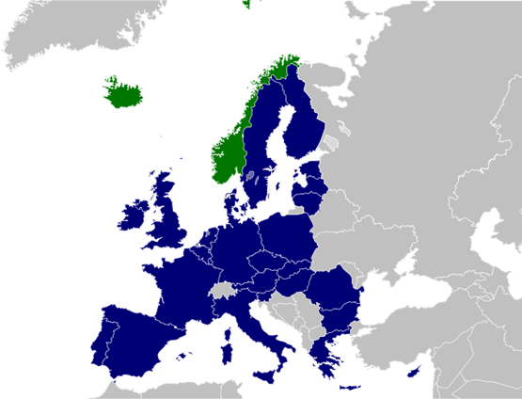
Alternatives to EU Membership: The Norwegian Model
Lectio Inauguralis
Achille e Giulia Boroli Chair in European Studies
Karen Helene Ulltveit-Moe
University of Oslo
Notes:
An alternative association to the EU – the EEA
20 years of experience as an outsider

Slide 2
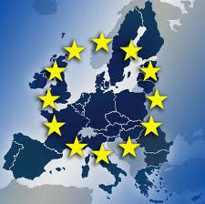
Why a Norwegian model?
A brief history of Norway
1397: Nordic Union (Kalmar Union)
Sweden left, Norway was not able
1537-1814: ruled by Denmark
1814: Denmark-Norway on the wrong side of the Napoleon wars; Denmark forced to give up Norway to Sweden
1814: Norway got its own constitution, but union between Norway and Sweden
1905: Union ended and King Haakon arrives
Norway-EU – a story of many «no»s
1972: Referendum No (53.5% out of 79.2%)
1994: Referendum No (52.2% out of 89%)

Slide 3
The EU-membership debate Not a referendum on immigration and globalization
Arguments pro EU-membership
Good for business
International peace cooperation
Europe
Impact – democracy
Participation in a block counterbalancing the US
Solidarity towards pooreer countries in Europe
Arguments pro EU-membership
National sovereignty
Too much bureaucracy
Threat against cultural identity
Too much market economy
Solidarity with the third world
Resistance against armed forces
Democratic deficit in the EU

Slide 4
The Norwegian Model
Norway’s relations with the EU are governed by a number of agreements
The most important and extensive agreement with the EU is the EEA agreement
negotiated 1989-1992
signed in 1992
went into force in 1.1.1994
in the wake of the second referendum on EU-membership (November 28, 1994), presumed to be temporary
Norway has seen
"extensive Europeanisation" in the past 20 years despite being outside the EU – substantial impact on domestic and foreign policy and most sectors
increased integration into Europe due to more agreements and more EU countries
no agreements or part thereof being reversed – despite fierce discussions
Notes:
President of the European commission Jacques Delors said to have soft spot for Gro Harlem Brundtland

Slide 5
An increasing number of agreements (Cumulative number of agreements with the EU based on on date of signing)
Notes:
Merk at det ikke er faste tidsintervall før 1989.
Kilde: UDs Traktatregister.

Slide 6
3/4 EU Member
EU law has been incorporated into around 1/3 of all Norwegian statues and approx 1000 Norwegian regulations
¾ member: Norway has incorporated approx three-quarters of all EU legislative acts into Norwegian legislation.
Major consensus: Norwegian authorities neither can nor wish to isolate Norway from ever closer and binding integration processes in the EU
Norway is far more closely associated with the EU than most people realise.
Unusual form of association: association without membership.
Norway’s association with the EU has not been the model for others - until Brexit
Notes:
recen

Slide 7
What is the EEA?
EEA brings together the EU and 3 out of 4 EFTA countries
EEA is an international agreement that allows the EFTA states to participate fully in the Single Market
covers the four freedoms
covers competition and state aid rules
covers horizontal policies on consumer protection, company law, environment, social policy and statistics
provides for cooperation in several flanking policies, e.g. research, education, employment, culture and enterprise
entered into force in 1992 – was thought to be a temporary agreement.
EEA is a dynamic agreement: the common rules of the EEA agreement are updated continuously with new EU legislation
Notes:
EEA legislation is primary the legislation of the EU and secondary legislation.
The EFTA surveillance authority (ESA) ensures that the EEA EFTA states fulfil their obligations under the EEA agreement
The EFTA court deals with the infringement actions brought against an EEA EFTA state with regard to the implementation, application and interpretation of EEA law

Slide 8
What is the EEA not?
EEA does not cover common agriculture and fisheries policies although provisions on trade in these products
EEA does not include
the customs union,
common trade policy
common foreign and security policy
justice and home affairs
direct and indirect taxation
Notes:
FT Nov 17, 2016
Jeroen Dijsselbloem (Head of the Eurogroup/Eurozone finance ministers): “…described Mr Johnson’s most recent speculation that Britain could be in the EU’s single market but outside its customs union as “intellectually impossible and politically unavailable”.

Slide 9
EEA review 2012: Main messages
The EEA a well functioning national compromise
Norway is neither completely outside nor fully inside
Inherent structural tensions and problems, but has worked much better than many expected.
Large economic benefits, but great democratic deficit since Norway has to adopt EU policies "without voting rights".
Norway is not represented in decision-making processes that have direct consequences for Norway and has no significant influence on them.
The form of association with the EU makes it difficult to monitor the Government and hold it accountable in its European policy.
Notes:
A government appointed committee reviewed Norway’s agreements with the EU 2010-2012 examining the political, legal, administrative, economic and other social consequences of the EEA Agreement - but was explicitly not asked to discuss alternative arrangements.

Slide 10
Still mixed attitudes towards EU-membership and the EEA
Source: Respons Analyse (2016)
Notes:
Brexit har skapt økt oppmerksomhet rundt vår tilknytningsform til EU
Synet på EØS er omtrent det samme da Sentio gjorde en undersøkelse for Europautredningen i 2011.
60+ svarte at det var en god avtale, 10 + vet ikke, 20+ dårlig avtale
Ikke et entydig syn på at EU er bra
Tendens til økt kritikk av EØS avtalen
Handel og Kontor, oktober 2016:
«HK vil støtte nye forhandlinger med EU med tanke på å fremforhandle en ny og bedre EØS-avtale.»
Fellesforbundet, september 2015:
14 av Fellesforbundets avdelinger foreslår for landsmøtet at organisasjonen må jobbe for å få Norge ut av EØS-avtalen. Ti avdelinger argumenterer for å beholde den.
«Landsmøtet i Fellesforbundet fastslår at EØS-avtalen er avgjørende for norsk næringslivs konkurranseevne. Landsmøtet krever også at Norge bruker det handlingsrommet EØS-avtalen gir.»

Slide 11
EEA review 2012: Main messages
Inherent Democratic deficit:
The democratic deficit is the price Norway pays for enjoying the benefits of European integration without being a member of the organisation, that is driving these developments.
Stable and predictable framework:
The EEA has ensured a stable and relatively predictable framework for relations with the EU, Norway’s most important economic partner.
More integrated in EU trade than many EU countries
Norway’s share of trade with EEA approx the same as in 1994
Even though Norwegian export has increased by 40 percent
Intra-EEA trade has increased even in times where the emerging markets have been on the rise
Relatively Cheap:
The EEA is a cheap agreement: Compared to natural peers , e.g. Sweden and Germany, Norway has paid considerably less relative to GDP; but gradually more.

Slide 12
Norway’s most important trade partner is (still) the EU
Source: SSB
Notes:
EU er Norges viktigste handelspartner - Et urolig er Europa er dårlig nytt
Storbritannia er vår viktigste handelspartner innen EU
Konsekvenser for Kina tar kun i mot 3% av norsk eksport, men 6% av fastlandseksporten, Sverige største avtaker av fastlandseksporten med 9%
Brexit – dårlig nytt for oss, kan miste markedsadgang, lite sannsynlig at når Storbritannia skal reforhandle alle handelsavtaler at de vil prioritere oss. Måtte være pga olje og gass

Slide 13
More integrated in the EU than many EU countries: Internal EEA trade (export +import): EEA countries’ trade with other EEA countries as share of total trade
Source: SSB and Eurostat
Notes:
Kilde: Eurostat og Statistisk sentralbyrå, 2010
- Close ties to the EU
- To some extent closer ties than among EU countries themselves

Slide 14
What have we learnt?
Non-tariff barriers matter:
The Single Market is not enough
Firms suffer from NTBs related to Norway not being member of the EU Customs union and the EU VAT
SMEs move business to Sweden to avoid obstacles
Firms/Industries not covered by the EEA have suffered
Lack of common competition and state aid rules has allowed for anti-dumping og anti-subsidie procedures against the fishery industry
Trade with the EEA has given smooth and slow structural change with less adjustment costs as compared to the opening of WTO towards the East
Trading with similar countries gives more modest gains but also less pain and lesser problems of redistribution
Forgone trade opportunities?
Baier et al (2008) estimate that the trade effect the EU is 3-4 times higher than that of the EEA, i.e. a significantly bigger positive effect on trade from EU membership than from EEA association
But better than “no deal” and a Free Trade Agreement
See Ebell (2016)

Slide 15
Robust to Brexit
Little knowledge and debate on EU matters:
until Brexit little debate about the EU, despite significant labor migration due to the Eastern enlargement
Significant labour migration from the East without tensions
Still stricter labour market regulation (e.g. working hours) – possible because most labour market directives are minimum directives
Based on in particular a law ensuring the general application of collective agreements, a downward pressure on wages due to labour immigration has been dampened.
Still low wage inequality, i.e. very different from the UK
Lessons for the UK:
Exiting the EU and banding immigration is not the solution to while domestic policies dampening the impact of migration on labour market and welfare system are.
Notes:
EØS avtalen har tjent oss vel fordi vi har beholdt vårt organiserte og regulerte arbeidsmarked.
Vi er blant de landene i EØS som først åpnet grensene for fullstendig fri flyt av arbeidskraft fra øst – men uten å deregulere det nasjonale arbeidsmarkedet. Vi har vært opptatt av å verne om arbeidstakernes rettigheter. Allmengjøring av tariffavtaler har hindret at utenlandsk arbeidskraft får dårligere lønns- og arbeidsvilkår enn det som er vanlig i Norge, og dermed bidratt til å dempe et nedadgående lønnspress.
Vår tilpasning til EØS-avtalen gjennom norsk arbeidsmarkedsregulering har således redusert fordelene av innvandring for eiere av for eksempel entreprenørforetak og verft. Men samtidig er tapene for de berørte norske arbeidstakerne redusert.
Storbritannia og USA skiller seg begge vesentlig fra Norge i sin tilpasning til globalisering. De har ikke hatt en aktiv omfordelingspolitikk og i enda mindre grad har de søkt å verne om sine arbeidstakere gjennom nasjonal arbeidsmarkedsregulering.
Og som man reder, ligger man. Da blir resultatet mange sinte menn og kvinner. De vil ikke bli hjulpet av verken murer eller lavere skatt.

Slide 16
The Norwegians’ attitude to Brexit
Source: Respons Analyse (2016)
Notes:
Negativ =45
Sml konsekvenser for EU: negativt=62
Nordmenns syn på Brexit
Imperiet?
Smitteeffekter?
As a result, EU exports to the Storbritannia are worth 3% of EU GDP, while Storbritannia exports to the EU are worth 13% of Storbritannia GDP – four times more. Also, almost half of all of our foreign investment comes from the EU.
eksport < import
44 % av eksporten går til EU
47% av vareeksporten
40% av tjenesteeksporten
8% av EUs eksport til Storbritannia

Slide 17
Massive immigration from the East: Doubling of migrants 2004-2013
Source: Eurostat

Slide 18
Positive attitudes towards migrants

Slide 19
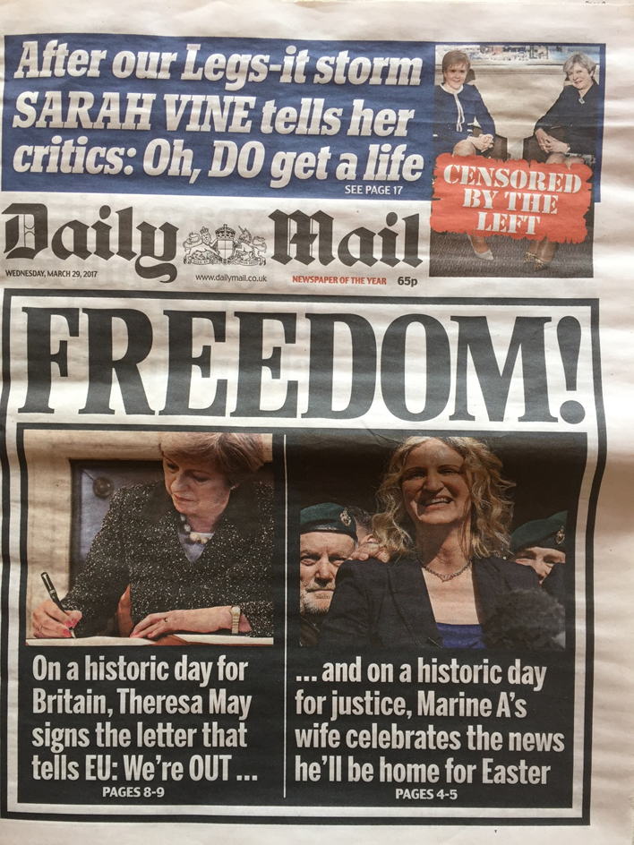
How to maintain support for the European project and international agreements?
Low inequality
High thrust
Sharing the gains from globalization and European integration
To avoid irrational and damaging
responses

Slide 20
Equality
Source: OECD

Slide 21
Confidence
Source: OECD
Notes:
Rød søyle indikerer fall i oppslutningen siden 2007

Slide 22
Thank You

